Slide 1



09.A Identifying Automatically Started System Processes
list system daemons and network services
started by systemd service and socket units

Slide 2

systemd
The systemd daemon manages startup for Linux, including service startup and service management in general.
It activates system resources, server daemons, and other processes both at boot time and on a running system

Slide 3
Daemons
Daemons are processes that either wait or run in the background, performing various tasks.
Generally, daemons start automatically at boot time and continue to run until shutdown or until they are manually stopped.
It is a convention for names of many daemon programs to end in the letter d

Slide 4
Services
A service in the systemd sense often refers to one or more daemons, but starting or stopping a service may instead make a one-time change to the state of the system, which does not involve leaving a daemon process running afterward (called oneshot).

Slide 5
DESCRIBING SERVICE UNITS
.service
.socket
.path
frequently accessed daemons, such as a web server.
inter-process communication (IPC) sockets that systemd should monitor
This is commonly used for services which use spool
directories such as a printing system.

Slide 6
systemctl
The systemctl command is used to manage units. For example, display available unit types with the systemctl -t help command.

Slide 7


LISTING SERVICE UNITS
[root@host ~]# systemctl list-units --type=service
UNIT LOAD ACTIVE SUB DESCRIPTION
atd.service loaded active running Job spooling tools
auditd.service loaded active running Security Auditing Service
[root@host ~]# systemctl list-units --type=service --all

Slide 8
VIEWING SERVICE STATES
[root@host ~]# systemctl status sshd.service
● sshd.service - OpenSSH server daemon
Loaded: loaded (/usr/lib/systemd/system/sshd.service; enabled; vendor preset:
enabled)
Active: active (running) since Thu 2019-02-14 12:07:45 IST; 7h ago
Main PID: 1073 (sshd)

Slide 9
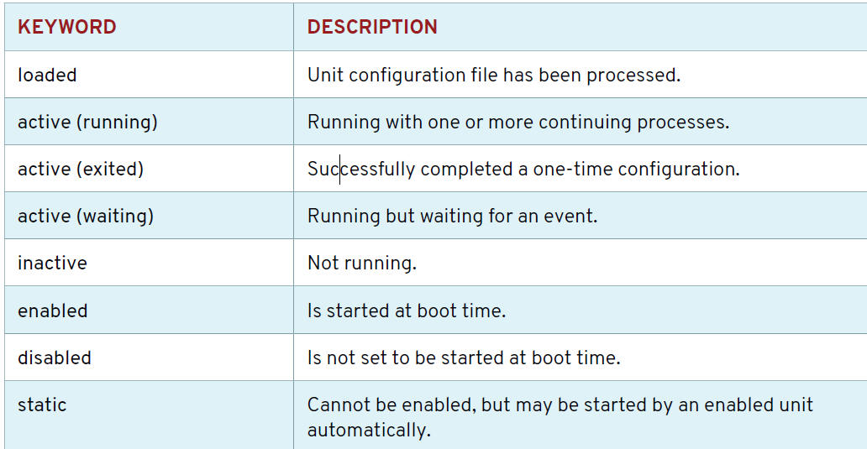
Service States in the Output of systemctl

Slide 10
VERIFYING THE STATUS OF A SERVICE
[root@host ~]# systemctl is-active sshd.service
Active
[root@host ~]# systemctl is-enabled sshd.service
Enabled
[root@host ~]# systemctl is-failed sshd.service
active

